Slide 1
Drop Down Menu

Slide 2

Menu & Drop Down Menu
<ul class="main">
<li><a href="#">Home</a></li>
<li><a href="#">About Us</a></li>
<li><a href="#">Drop Down</a>
<ul class="sub"><li><a href="#">Logout</a></li><li><a href="#">Settings</a></li></ul>
</li>
</ul>

Slide 3
<style type="text/css">
.main{
list-style:none;
padding:0px;
margin:0px;
}
.main li{
background-color:red;
display:inline-block;
position: relative;
}
.sub{
list-style:none;
display:none;
padding:0px;
margin:0px;
}
.main li:hover .sub{
display:block;
position: absolute;
}
.sub li{
width:100%;
}
ul li a{
text-decoration:none;
}
ul li a:hover{
text-decoration:underline;
}
ul li:hover{
background-color:yellow;
}
</style>

Slide 4
CSS z-index Property
img { position: absolute; left: 0px; top: 0px; z-index: -1; }
Definition and Usage
The z-index property specifies the stack order of an element.
An element with greater stack order is always in front of an element with a lower stack order.
Note: z-index only works on positioned elements (position:absolute, position:relative, or position:fixed).

Slide 5
Frames and Media Queries

Slide 6
Frames
Frames are a relatively new addition to the HTML standard. First introduced in Netscape Navigator 2.0.
Objectives:
Upon completing this section, you should be able to:
Create a Frame based page.
Work with the Frameset, Frame, and Noframes elements.
Use the attributes of the Frames elements to control the display.

Slide 7
Frames
A framed page is actually made up of multiple HTML pages. There is one HTML document that describes how to break up the single browser window into multiple windowpanes. Each windowpane is filled with an HTML document.
For Example to make a framed page with a windowpane on the left and one on the right requires three HTML pages. Doc1.html and Doc2.html are the pages that contain content. Frames.html is the page that describes the division of the single browser window into two windowpanes.

Slide 8
Frames
Doc1.html
Doc2.html
Doc1.html
Doc2.html
Frames.html

Slide 9
Frame Page Architecture
A <FRAMESET> element is placed in the html document before the <BODY> element. The <FRAMESET> describes the amount of screen real estate given to each windowpane by dividing the screen into ROWS or COLS.
The <FRAMESET> will then contain <FRAME> elements, one per division of the browser window.
Note: Because there is no BODY container, FRAMESET pages can't have background images and background colors associated with them.

Slide 10
Frame Page Architecture
<HTML>
<HEAD>
<TITLE> Framed Page </TITLE>
<FRAMeSET COLS=“23%,77%”>
<FRAME SRC=“Doc1.html”>
<FRAME SRC=“Doc2.html”>
</FRAMeSET >
</HEAD>
</HTML>

Slide 11
The Diagram below is a graphical view of the document described above
FRAMESET COLS=”23%, 77%”
FRAME
NAME= left_pane
SRC=Doc1.html
FRAME
NAME=right_pane
SRC= Doc2.html

Slide 12
<FRAMESET> Container
<FRAMESET> : The FRAMESET element creates divisions in the browser window in a single direction. This allows you to define divisions as either rows or columns.
ROWS : Determines the size and number of rectangular rows within a <FRAMESET>. They are set from top of the display area to the bottom.
Possible values are:
Absolute pixel units, I.e. “360,120”.
A percentage of screen height, e.g. “75%,25%”.
Proportional values using the asterisk (*). This is often combined with a value in pixels , e.g. “360,*”.
<Frameset cols=“200,20%,*,2*”>

Slide 13
Creating a Frames Page
COLS: Determines the size and number of rectangular columns within a <FRAMESET>. They are set from left to right of the display area.
Possible values are:
Absolute pixel units, I.e. “480,160”.
A percentage of screen width, e.g. “75%,25%”.
Proportional values using the asterisk (*). This is often combined with a value in pixels , e.g. “480,*”.

Slide 14
Creating a Frames Page
FRAMEBORDER : Possible values 0, 1, YES, NO. A setting of zero will create a borderless frame.
FRAMESPACING: This attribute is specified in pixels. If you go to borderless frames you will need to set this value to zero as well, or you will have a gap between your frames where the border used to be.
BORDER(thickness of the Frame): This attribute specified in pixels. A setting of zero will create a borderless frame. Default value is 5.
BORDERCOLOR: This attribute is allows you choose a color for your border. This attribute is rarely used.

Slide 15
<FRAME>
<FRAME>: This element defines a single frame within a frameset. There will be a FRAME element for each division created by the FRAMESET element. This tag has the following attributes:
SRC: Required, as it provides the URL for the page that will be displayed in the frame.
NAME: Required for frames that will allow targeting by other HTML documents.

Slide 16
<FRAME>
MARGINWIDTH: Optional attribute stated in pixels. Determines horizontal space between the <FRAME> contents and the frame’s borders.
MARGINHEIGHT: Optional attribute stated in pixels. Determines vertical space between the <FRAME> contents and the frame’s borders.
SCROLLING: Displays a scroll bar(s) in the frame. Possible values are:
Yes – always display scroll bar(s).
No – never display scroll bar(s).
Auto – browser will decide based on frame contents.
By default: scrolling is auto.

Slide 17
<FRAME>
NORESIZE: Optional – prevents viewers from resizing the frame. By default the user can stretch or shrink the frame’s display by selecting the frame’s border and moving it up, down, left, or right.

Slide 18
Compound FRAMESET Divisions
<html>
<head>
<frameset rows=“120,*”>
<frame src=“banner_file.html” name”banner”>
<frameset cols=“120,*”>
<frame src=“links_file.html” name=“links”>
<frame src=“content_file.html” name=“content”>
</frameset>
</frameset>
</head>

Slide 19
Compound FRAMESET Divisions You may want to create a frames design with a combination of rows and columns.
Banner File
Links
File
Contents File

Slide 20
Compound FRAMESET Divisions Example
<HEAD>
<FRAMESET ROWS="25%,50%,25%”
<FRAME SRC="">
<FRAMESET COLS="25%,*">
<FRAME SRC="">
<FRAME SRC="">
</FRAMESET>
<FRAME SRC="">
</FRAMESET>
</HEAD>

Slide 21
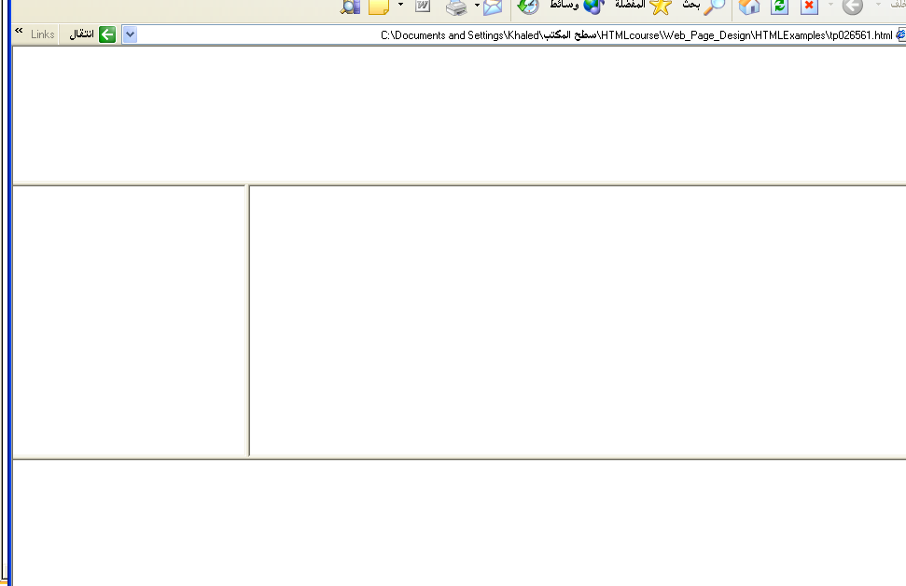
Output

Slide 22
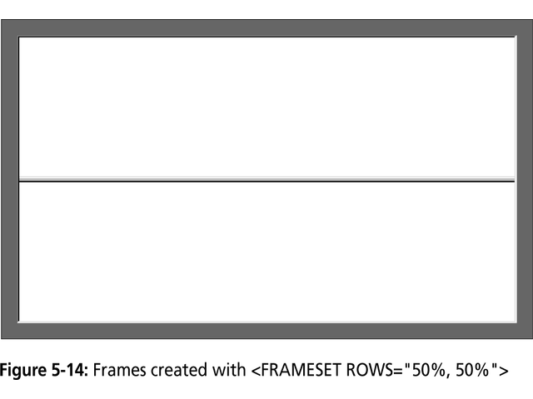

Slide 23
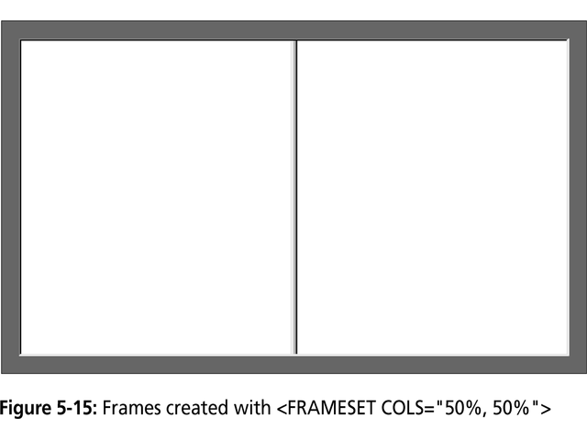

Slide 24
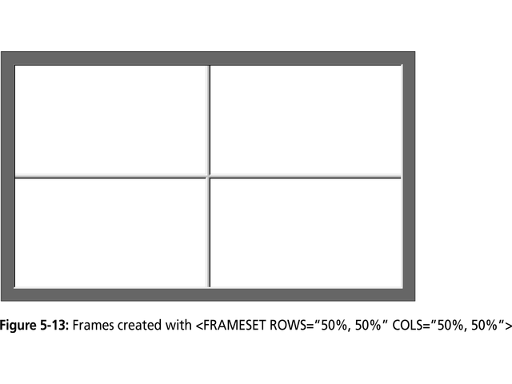

Slide 25
Frame Formatting
Example:
<frameset rows=“20%, *, 20%”>
<frame src=“header.html” noresize scrolling=no>
<frame src=“body.html”>
<frame src=“navigationbar.html” noresize scrolling=no>
</frameset>

Slide 26
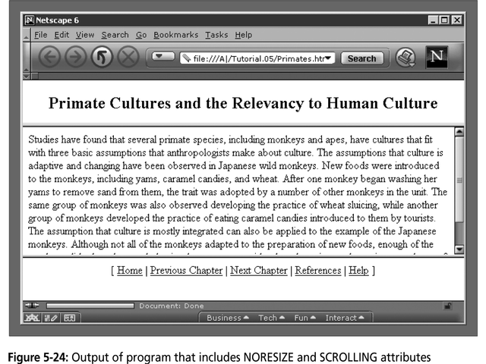

Slide 27
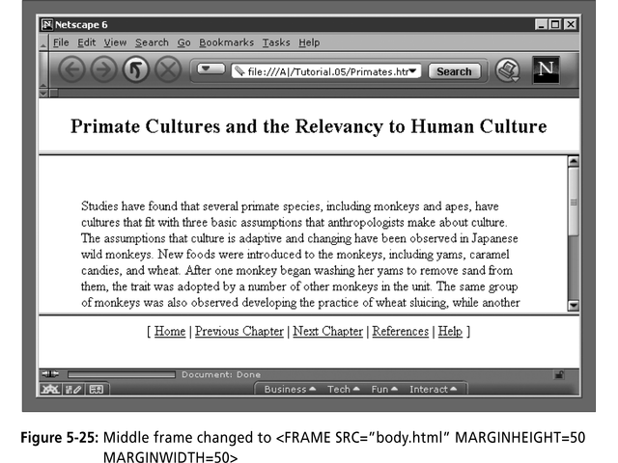

Slide 28
Generic Frame Formula
The <FRAME> tag has six associated attributes: SRC, NAME, MARGINWIDTH, MARGINHEIGHT, SCROLLING, and NORESIZE. Here's a complete generic FRAME:
<FRAME SRC="url" NAME="window_name" SCROLLING=YES|NO|AUTO MARGINWIDTH="value" MARGINHEIGHT="value"
NORESIZE>

Slide 29
Media Query
Media query is a CSS technique introduced in CSS3.
It uses the @media rule to include a block of CSS properties only if a certain condition is true

Slide 30
<!DOCTYPE html>
<html>
<head>
<style>
body {
background-color:lightgreen;
}
@media screen and (min-width: 480px) {
body {
background-color: lightblue;
}
}</style>
</head>
<body>
<p>Resize the browser window. When the width of this document is less than 500 pixels, the background-color is "lightblue", otherwise it is "lightgreen".</p>
</body>
</html>

Slide 31
<!DOCTYPE html>
<html>
<head>
<style>
body {
background-color:lightgreen;
}
@media screen and (min-width: 500px) {
body {
background-color:lightblue;
}
}
</style>
</head>
<body>
<p>Resize the browser window. When the width of this document is less than 500 pixels, the background-color is " lightgreen ", otherwise it is " lightblue ".</p>
</body>
</html>

Slide 32
RESONSIVE DESIGN with
BOOTSTRAP

Slide 33
INTRODUCTION
Bootstrap is an Open-Source front-end Frame-work.
Bootstrap 3.3.6 is the current version of bootstrap
It is for creating responsive websites and web applications.
It contains HTML and CSS-based design templates for forms, buttons, navigation and other interface components, as well as optional JavaScript extensions.
It is the No.1 project on Github with 65,000+ stars and 23,800 forks (as of March 2014)(http://en.wikipedia.org/wiki/Bootstrap_(front-end_framework)).
Bootstrap Official Address (http://getbootstrap.com/ ).

Slide 34
What’s new in Bootstrap
Mobile-first approach
Single (responsive) grid system
Dropping support for IE7 and FF 3.6
Now supporting IE8 and higher
Font icons

Slide 35

What is Responsive Design ?
The design that works properly on any resolution .
It majorly concerns with standard devices resolutions.
User friendly approach.

Slide 36
Bootstrap standard devices resolution?
Extra small devices i.e Phones (<768px),Symbol (-xs-),column width(Auto).
Small devices i.e Tablets (≥768px),Symbol (-sm-),column width(60px).
Medium devices i.e Desktop (≥992px),Symbol (-md-),column width(78px).
Large devices i.e Desktop (≥1200px),Symbol (-lg-),column width(95px).

Slide 37
What is the most important thing to understand in Bootstrap?
Grid System
Bootstrap includes a responsive, mobile first fluid grid system that appropriately scales up to 12 columns as the device or viewport size increases. It includes predefined classes for easy layout options.
Grid systems are used for creating page layouts through a series of rows and columns that house your content.
Grid classes apply to devices with screen widths greater than or equal to the breakpoint sizes, and override grid classes targeted at smaller devices. Therefore, applying any -md- class to an element will not only affect its styling on medium devices but also on large devices if a -lg- class is not present.

Slide 38
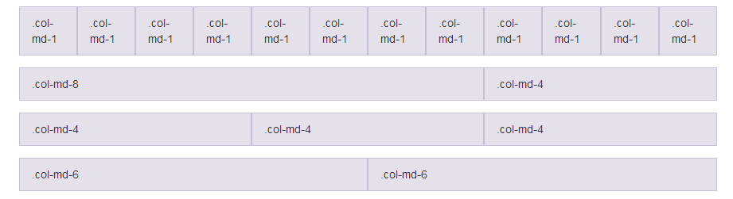
Bootstrap Grid System Example :

Slide 39
Bootstrap Glyphicons :
These are SVG , scalable vectors graphics .
Around 200 icons are available for free with bootstrap.
How to use
For performance reasons, all icons require a base class and individual icon class. To use, place the following code just about anywhere. Be sure to leave a space between the icon and text for proper padding.
<div> <span class="glyphicon glyphicon-search"></span> </div>

Slide 40
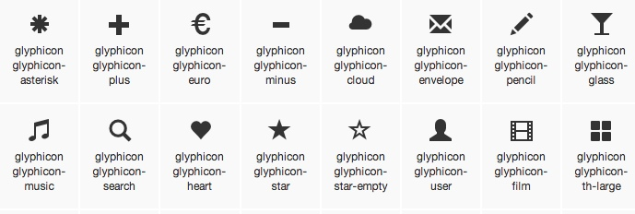

Slide 41
Bootstrap other components :
Dropdown
Button Group
Navigations
Pagination
Thumbnails
Alerts
Progress Bars
Panels … etc.

Slide 42
Bootstrap CSS:
Tables
Forms
Buttons
Images
…etc.

